Slide 1
PERSONAL EXPENSE TRACKER
IBM PROJECT
MEMBERS
GOWTHAM K
ADHITHYA M
DHARSHAN J
IMMANUEL NOWPERT T
MENTOR
U.M.Ramya M.E.,

Slide 2
Abstract
The web application “Personal Expense Tracker” is used to manage the expense made by an individual or a group likely to be a family. Here a family can have multiple logins. In this application, user can provide his income to calculate his total expenses per day and these results will be stored for each user.
The privileges are to add type of expense, verify expense, add type of income, verify income and generate reports. Even we can track through the dates.

Slide 3
Problem Statement
In simple words, personal finance entails all the financial decisions and activities that a Finance app makes your life easier by helping you to manage your finances efficiently. A personal finance app will not only help you with budgeting and accounting but also give you helpful insights about money management.
Personal finance applications will ask users to add their expenses and based on their expenses wallet balance will be updated which will be visible to the user. Also, users can get an analysis of their expenditure in graphical forms. They have an option to set a limit for the amount to be used for that particular month if the limit is exceeded the user will be notified with an email alert.

Slide 4
System Requirments
8GB RAM
Intel Core i3
OS-Windows/Linux/MAC ,Laptop or Desktop

Slide 5
Literature Survey
Intelligent Online Budget Tracker
The development of this application has been conducted in a stepwise manner using the well-defined methodology, RUP, customized according to the requirements of the system. Most of the goals set at the start of the development phase have been met. Security problems like web security or network security have also been treated in the design and development of the system, thus increasing the reliability of the system. Quality management issues have also been handled satisfactorily.

Slide 6
Literature Survery
B. Online Income and Expense Tracker
This project is work more efficient than the other income and expense tracker. The project successfully avoids the manual calculation for calculating the income and expense per month. The modules are developed efficiently and also in an attractive manner.

Slide 7
Literature Survey
C. Awareness On Digital Money
Now a days we are using the digital money so we don’t know how much money we are sending on a single click. So, there must be a proper tracking of the daily expense . It shows how far the money is being spent .

Slide 8
Existing Methodologies
The Expense tracker existing system does not provide the user portable device management level, existing system only used on desktop software so unable to update anywhere expenses done and unable to update the location of the expense details disruptive that the proposed system provides . In existing, we need to maintain the Excel sheets, CSV files for the user daily, weekly and monthly expenses. In existing, there is no as such complete solution to keep a track of its daily expenses easily. To do so a person as to keep a log in a diary or in a computer system, also all the calculations need to be done by the user which may sometimes results in mistakes leading to losses.

Slide 9
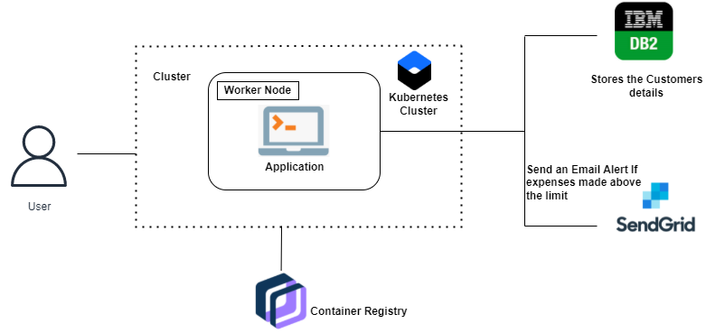
Proposed Architecture

Slide 10
Module Split
Registration – By creating user id, password – Immanuel Nowpert , Adhithya
Dashboard – The space where all details about the user is viewed - Gowtham
Expense – Add , Remove , Edit the individual bills – Immanuel Nowpert
Expense – Split the amount – Adhithya

